Slide 1
Travel booking application
Mohan Vaidya (233109) and Abhishek Shandilya (233123)

Slide 2
INTRODUCTION
As the world becomes more interconnected, travelers seek simplicity, convenience, and security in their journeys. Our Travel Booking System answers this call, reimagining the travel planning process. Through intuitive user interfaces, secure payment gateways, and comprehensive search and booking capabilities, we have created a platform that empowers users to curate their dream vacations effortlessly.

Slide 3
Purpose
The purpose of our Travel Booking Application is to revolutionize the way individuals plan, book, and experience their travel journeys. In a world where time and convenience are paramount, our application aims to:
Streamline Travel Planning: The application simplifies the entire travel planning process, from exploring destinations to booking accommodations and activities. Users can access a comprehensive range of options, tailored to their preferences, in one convenient platform.
Enhance User Experience: By offering an intuitive and user-friendly interface, the application ensures a seamless and enjoyable experience for travelers. It eliminates the complexities often associated with travel planning, making it accessible to individuals of all tech-savviness levels.
Provide Real-Time Information: Our application keeps travelers informed with real-time updates on flight availability, hotel vacancies, and activity schedules. This ensures that users are always equipped with the latest information to make informed decisions.
Secure and Efficient Payments: With integrated secure payment gateways, users can confidently make payments for bookings, eliminating concerns about online transactions. The application provides a hassle-free way to complete bookings and manage financial transactions.

Slide 4
Technologies used
We used Java Spring-Boot as backend and React JS as Frontend in our Project.
Spring-Boot :–
The main goal of the Spring Boot framework is to reduce overall development time and increase efficiency. React has become the first choice for frontend because it gives developers the ability to work with a virtual browser (more friendly than the real browser). Also, a JavaScript developer can become a productive developer in a few hours because there is a small API to learn, a few functions, and how to use them…
React :–
React allows developers to create large web applications that can change data, without reloading the page. The main purpose of React is to be fast, scalable, and simple. Spring

Slide 5
MOdules
Login (CUSTOMER and ADMIN)
Signup(CUSTOMER)
Tour search
Book tour
Add package (admin)
Fetch users(admin)
Fetch all bookings(admin)
My-Bookings(customer)

Slide 6
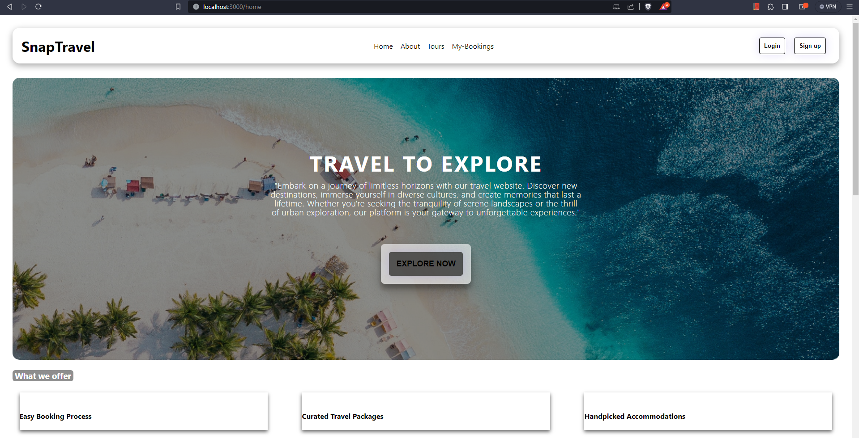
Home
Home page shows all the actions that can be performed on the application.
The Navbar is dynamic and provide links to route through application.
The explore button links to the tours which user can browse.

Slide 7
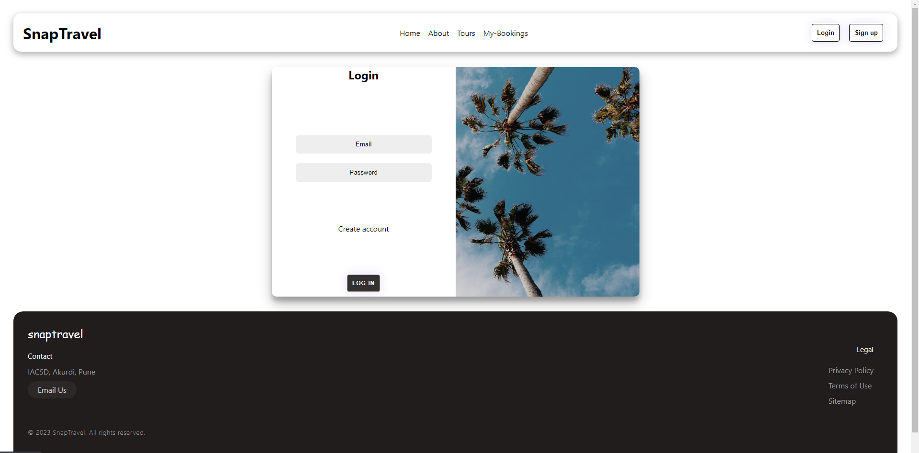
login
Access the application securely with personalized credentials.
Provides a secure gateway for registered users to access their accounts.
Enhances user experience by offering quick access to personalized features.

Slide 8
signup
New users can easily create accounts by providing basic information.
Enables users to access exclusive features and benefits.
Secure registration process ensures the safety of user data.

Slide 9
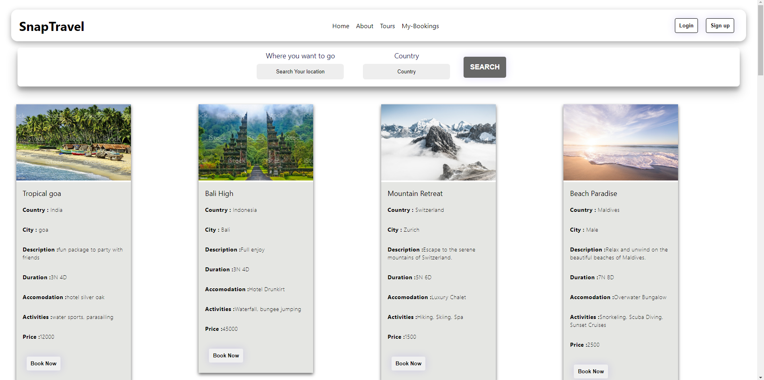
Search tour
Explore a diverse range of travel packages and destinations.
Browse tours based on location, duration, price, and activities.
User-friendly interface makes discovering exciting travel options easy and enjoyable.

Slide 10
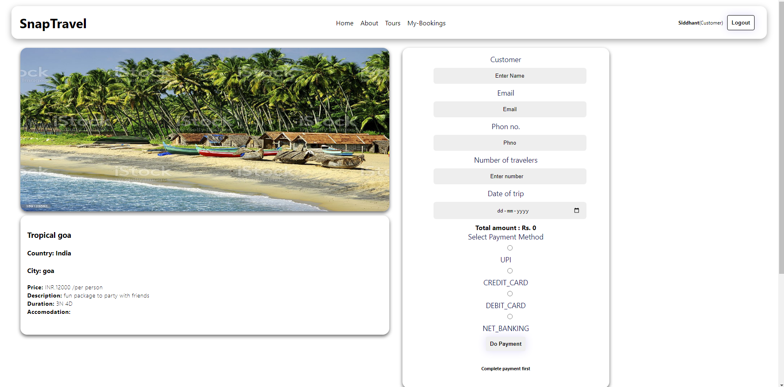
Book tour
Select desired travel package and customize options.
Choose travel dates, accommodations, and additional activities.
Streamlined booking process ensures a hassle-free experience.

Slide 11
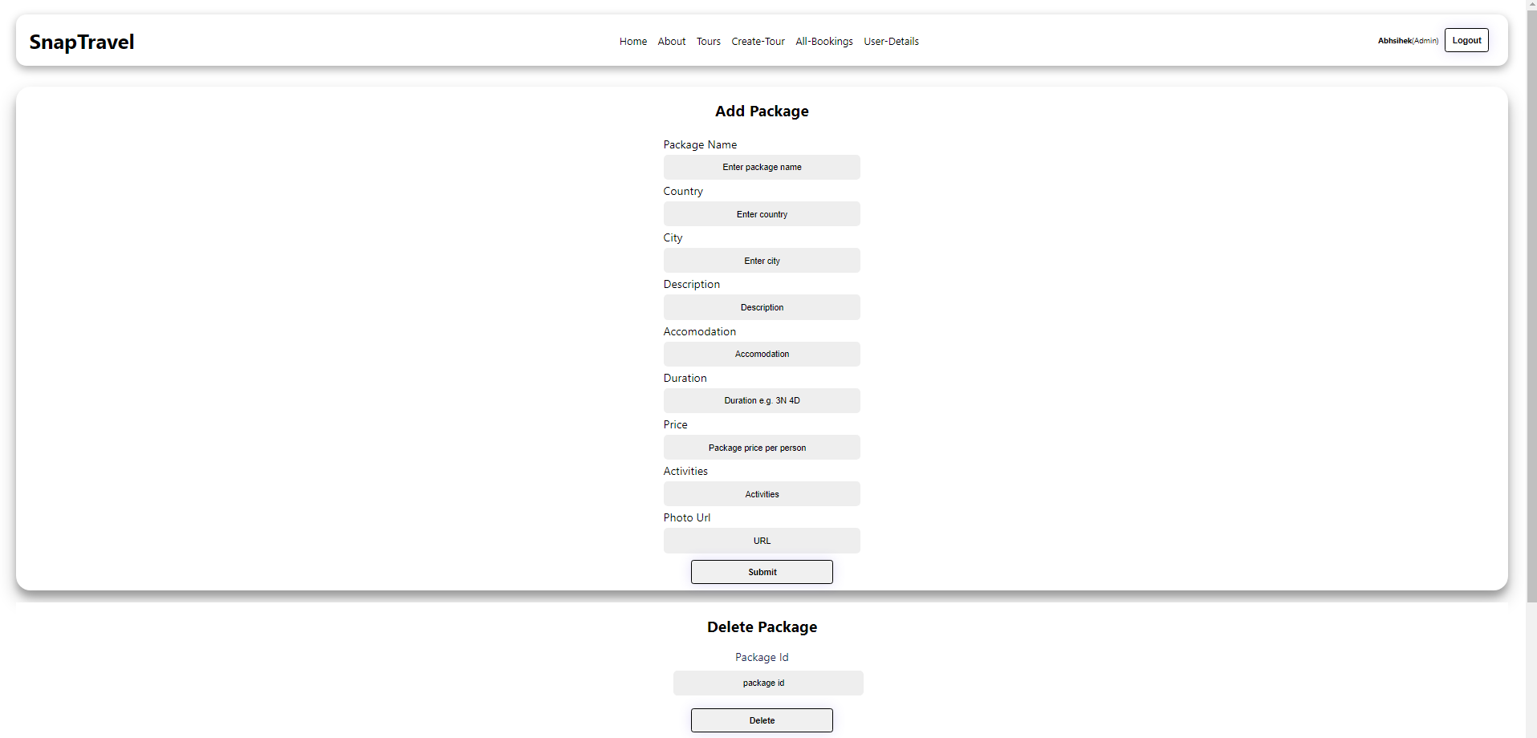
Add tour (admin)
Empowers travel agencies to add new travel packages to the platform.
Provide detailed package information such as name, description, and pricing.
Upload images to showcase the package and attract potential travelers.

Slide 12
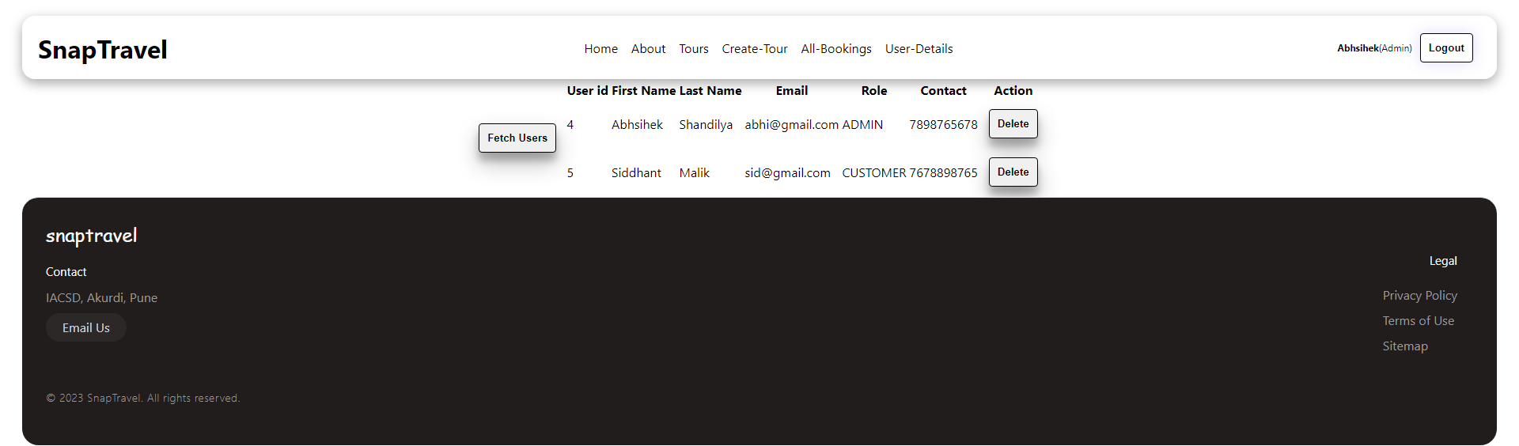
fetch users (admin)
Administrators can retrieve user information and profiles.
Enables personalized communication and support for users.
Provides insights into user preferences for better service delivery.

Slide 13
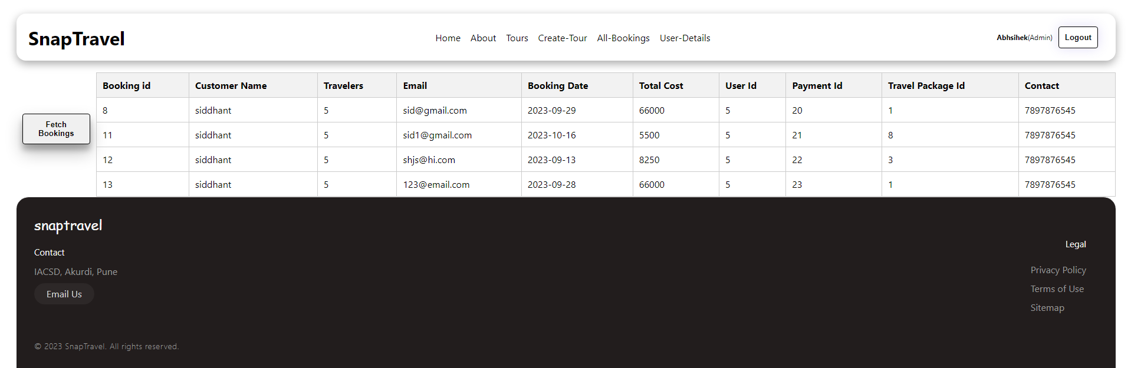
fetch All bookings (admin)
Administrators can access a comprehensive view of all bookings made.
Monitor the status of bookings, available accommodations, and activities.
Enables effective management and allocation of resources.

Slide 14
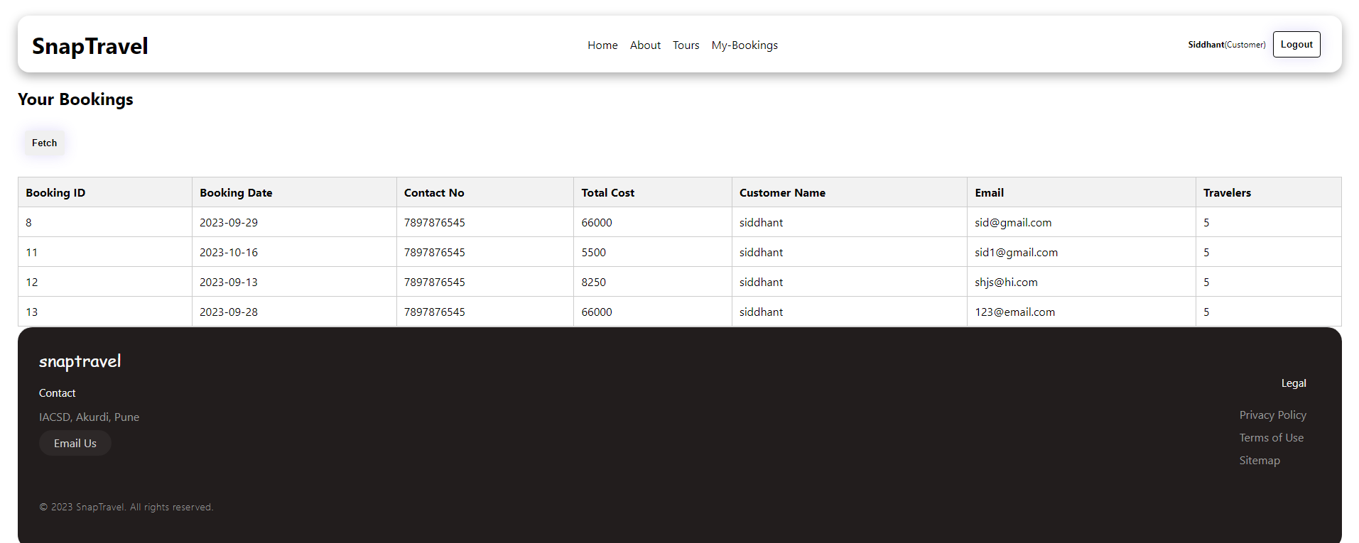
my bookings (admin)
Registered users can view and manage their booked tours.
Access booking details, including dates, activities, and total cost.
Provides a convenient way to track and organize upcoming travels.

Slide 15
SUMMARY
Our Travel Booking Application offers a comprehensive suite of features to enhance the travel experience for both users and administrators. From seamless booking to efficient management, our application ensures a user-friendly and efficient journey.
Key Modules:
Login and Signup: Secure access and personalized registration for users.
Browse Tours: Discover a variety of travel packages based on preferences.
Book Tour: Effortlessly customize and confirm travel arrangements.
Create Tour: Empower travel agencies to showcase new packages.
My Bookings: Manage and track individual booked tours.
All Bookings: Administrators oversee and optimize resource allocation.
Fetch Users: Admins access user profiles for personalized support.
With our intuitive interface, efficient booking process, and robust administrative tools, our Travel Booking Application aims to redefine the travel booking experience, ensuring convenience, choice, and memorable journeys for all.
Feel free to add relevant graphics, branding elements, and transition effects to make your summary slide visually engaging and impactful.

Slide 16
Thank you

